Slide 1
rs21- ArcGis
Various customer scenarios with personalized maps

Slide 2
Purpose of maps
After being matched to a county, the real estate agency’s customer will be given a customized map after choosing one of the following interests:
Entertainment
Public Transportation
Hospitals
Religious Facilities

Slide 3
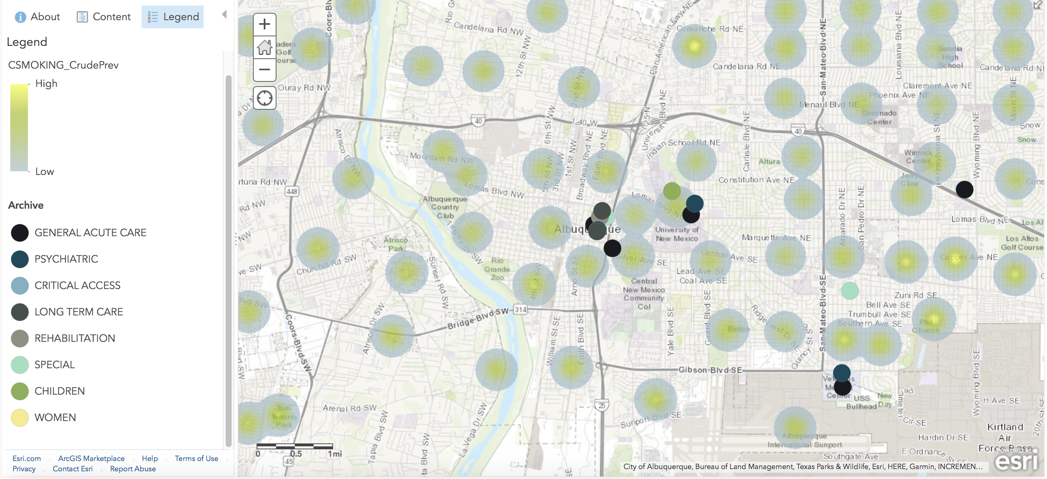
Map for A customer looking for support and hospitals to Help him quit smoking
Dataset: 500_Cities_Census_Tract_Level_Data_2017
&
’Hospitals’ from ABQ shapefiles
Link:
https://arcg.is/zLP5e

Slide 4
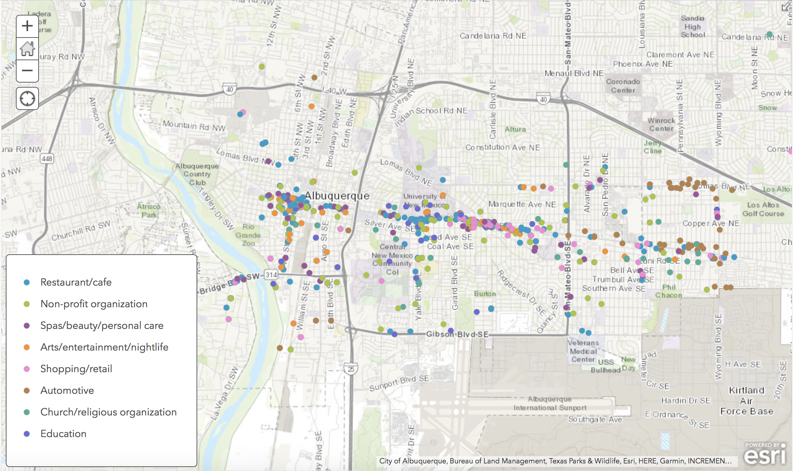
Map for a Young adult wanting to live near restaurants & Entertainment
Dataset: FacebookPlaces_Albuquerque
Link:
https://arcg.is/0HyzW1

Slide 5
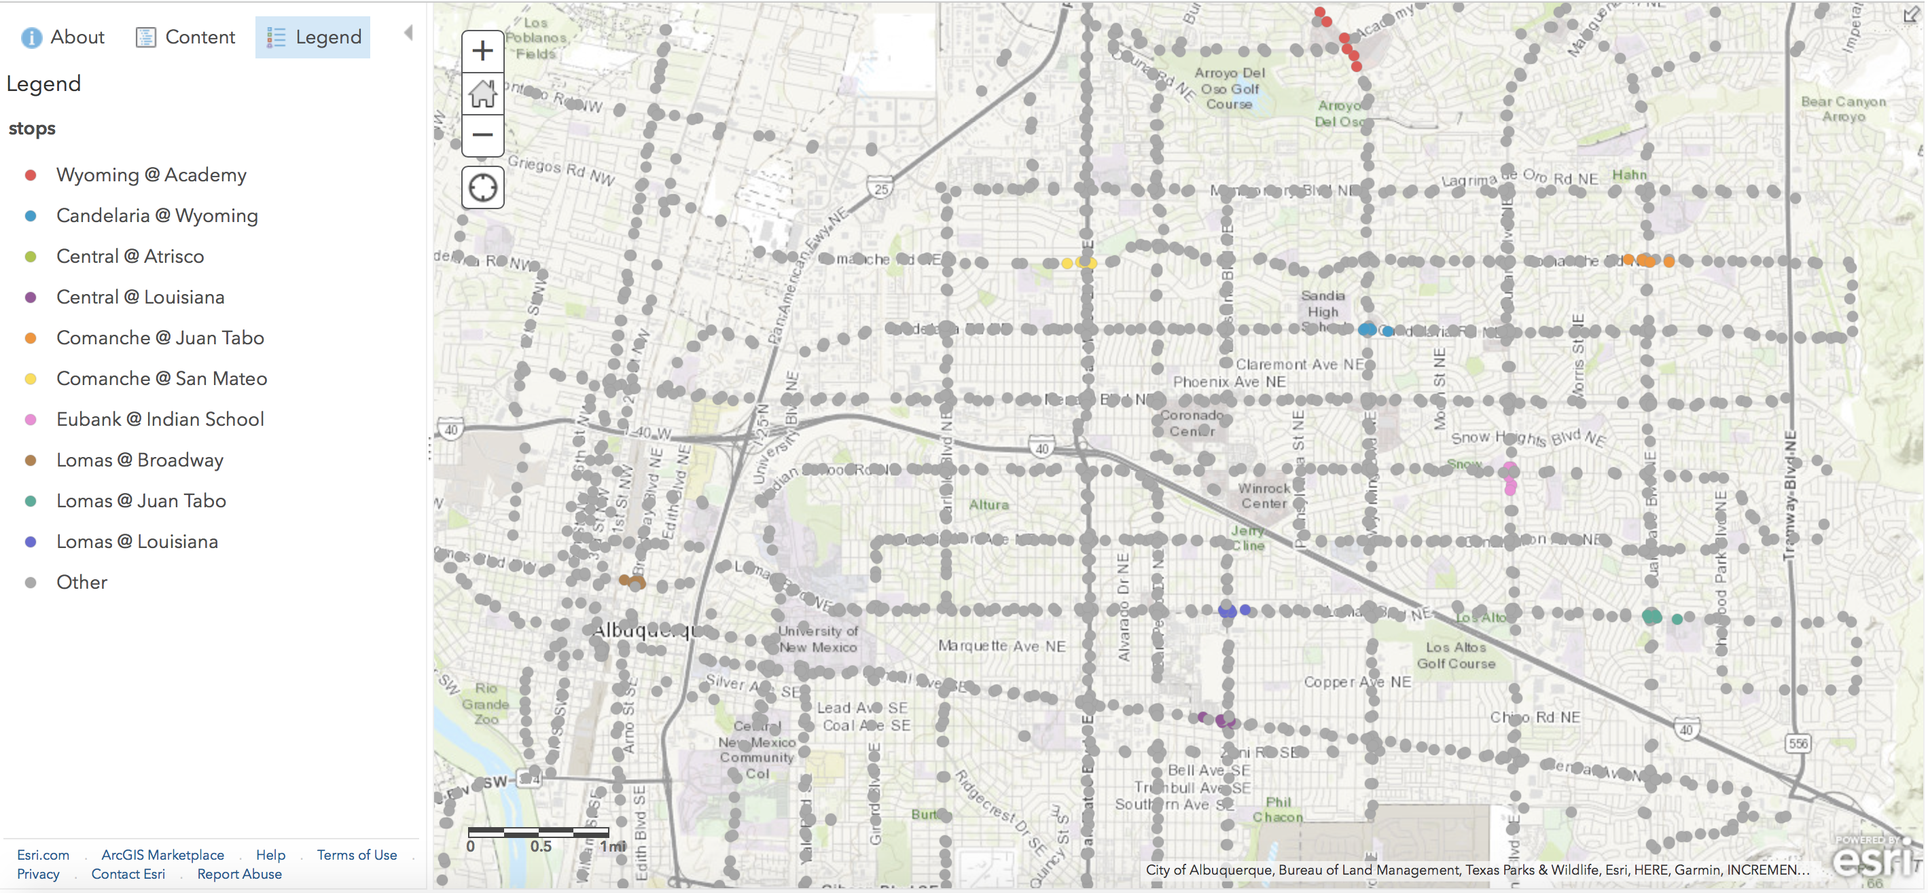
Map for Student who will rely on public transportation Near UNM

